Slide 1


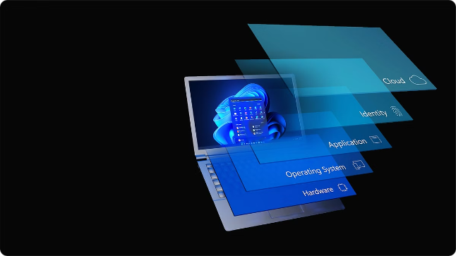
Introduction to Windows Operating System Security
The Windows operating system is designed with robust security features to protect users, data, and the overall system. This unit will provide an overview of the key security components that make Windows a secure and reliable platform.

Slide 2
Windows Security Architecture
Multi-Layer Defense
Integrated Security
Continual Updates
Windows security is built on a multi-layered approach, with various components working together to provide comprehensive protection.
Security features are deeply integrated into the Windows operating system, providing seamless protection across the entire platform.
Windows is regularly updated with the latest security patches and enhancements to address evolving threats and vulnerabilities.

Slide 3

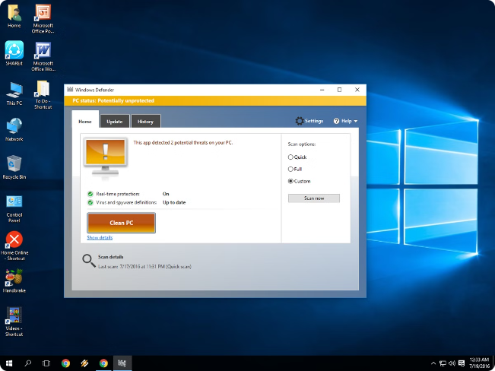
Windows Defender and Windows Defender Antivirus
1
Real-Time Protection
2
Cloud-Based Intelligence
Windows Defender Antivirus provides real-time protection against viruses, malware, and other cyber threats.
Windows Defender leverages cloud-based threat intelligence to quickly identify and respond to emerging threats.
3
Automatic Updates
Windows Defender is automatically updated to ensure the latest security definitions are in place.

Slide 4
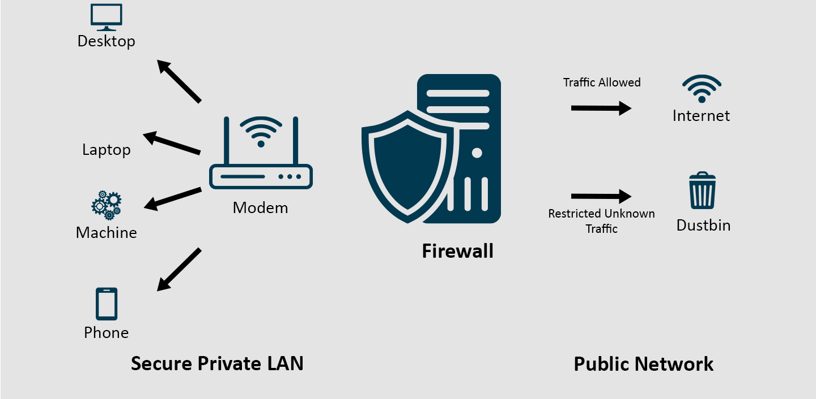




Windows Firewall and Advanced Security
Network Protection
Customizable Rules
Advanced Configuration
The Windows Firewall controls incoming and outgoing network traffic, shielding the system from unauthorized access.
Windows Firewall allows users to create custom security rules to further fine-tune network access policies.
Windows Advanced Security provides granular control over firewall settings and additional security features.

Slide 5

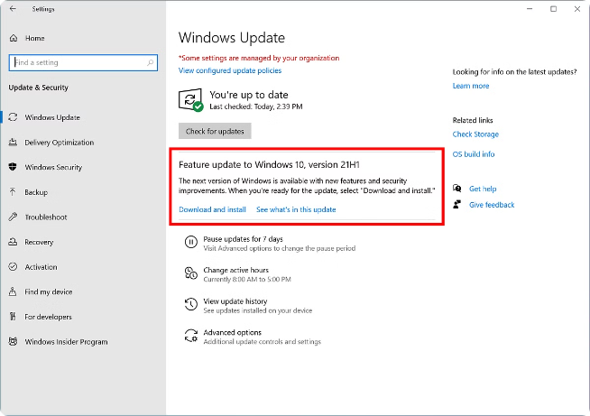
Windows Update and Patch Management
1
Automatic Updates
Windows Update automatically downloads and installs security patches and software updates to keep the system secure.
2
Manual Control
Users can also manually check for and install updates to ensure their system is up-to-date.
3
Centralized Management
Windows Update can be managed centrally through Group Policies and Windows Server Update Services (WSUS).

Slide 6

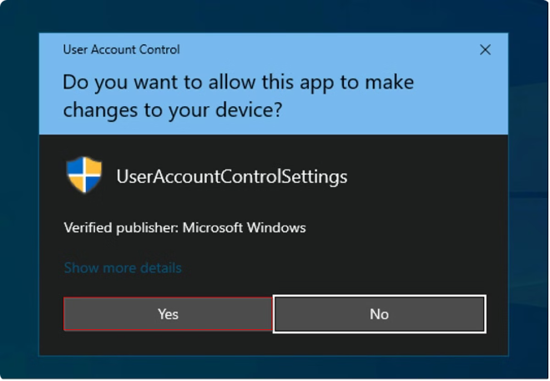
User Account Control (UAC) and Privilege Management
Privilege Separation
Elevation Prompts
UAC separates standard user accounts from administrator accounts, limiting the potential damage of malware or unauthorized actions.
UAC prompts users for permission before allowing programs to make changes that require administrative privileges.
Least Privilege
Granular Control
Windows follows the principle of least privilege, granting users only the minimum permissions necessary to perform their tasks.
Windows offers granular control over user permissions through Group Policies and local security settings.

Slide 7

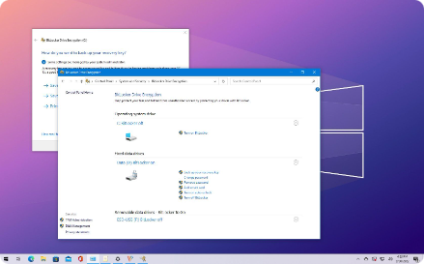



Windows Encryption and BitLocker
Full Disk Encryption
Multi-Factor Authentication
Enterprise Management
BitLocker provides full disk encryption, protecting data on both internal and external storage devices.
BitLocker supports various authentication methods, including passwords, PINs, and USB keys, to secure the encryption process.
BitLocker can be centrally managed and enforced through Group Policies, ensuring consistent encryption policies across the organization.

Slide 8

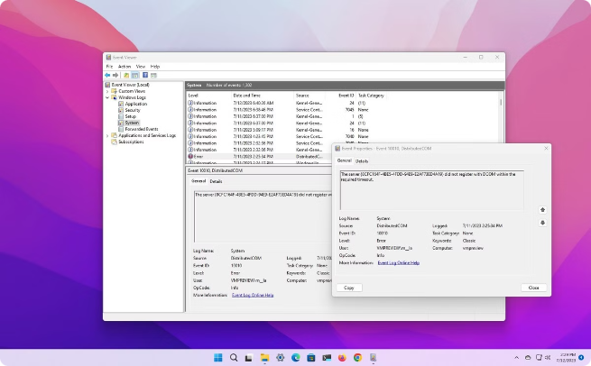
Windows Audit and Event Logging
Security Auditing
Windows logs security-related events, such as user logons, file access, and policy changes, to help identify and investigate security incidents.
Centralized Monitoring
Windows Event Viewer provides a centralized interface to view and analyze logged security events across the system.
Advanced Filtering
Windows supports advanced filtering and custom views to help security analysts quickly identify and respond to critical security events.

Slide 9
Windows Security Policies and Group Policies
Centralized Management
Granular Control
Inheritance and Delegation
Group Policies enable IT administrators to centrally define and enforce security configurations across an organization's Windows systems.
Group Policies offer granular control over various security settings, such as password policies, account lockout, and software restrictions.
Group Policies support inheritance and delegation, allowing administrators to easily apply and manage security policies at different organizational levels.

Slide 10

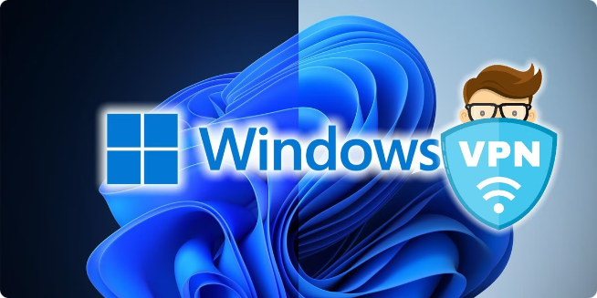
Securing Remote Access and Virtual Private Networks (VPNs)
1
Secure Remote Access
2
VPN Encryption
Windows provides built-in support for secure remote access, allowing users to connect to the corporate network while working remotely.
Windows supports various VPN protocols, such as PPTP, L2TP, and IKEv2, to encrypt and protect remote connections.
3
Multi Factor Authentication
Windows can be configured to require multifactor authentication for remote access, adding an extra layer of security.

